Slide 1
Bar in a Bar chart

Slide 2
Bar in a Bar chart
Steps:
Drag profit in rows and order date in col.
Drag category in color and select stacked bar chart from show me option.
Drag category in filters and select any two categories.
Drag category in size.
From the analysis option above select stack marks “off”.

Slide 3
Lollipop Charts

Slide 4
Lollipop Charts
Steps:
Drag region in col and sales in rows
Drag sales again in rows and make dual axis.
In the marks in first sales change it to bar.
Right click on the right side axis and select synchronize.
In the marks first sales change size & color.
In the second sales change the color.
Right click on right side axis and hide axis by clicking show header.
Drag sales into label in second sales.
Drag profit into label for second sales.
Put profit in size for second sales.

Slide 5
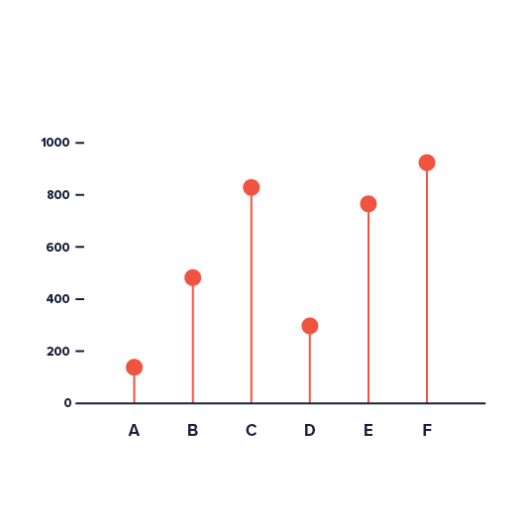

Slide 6
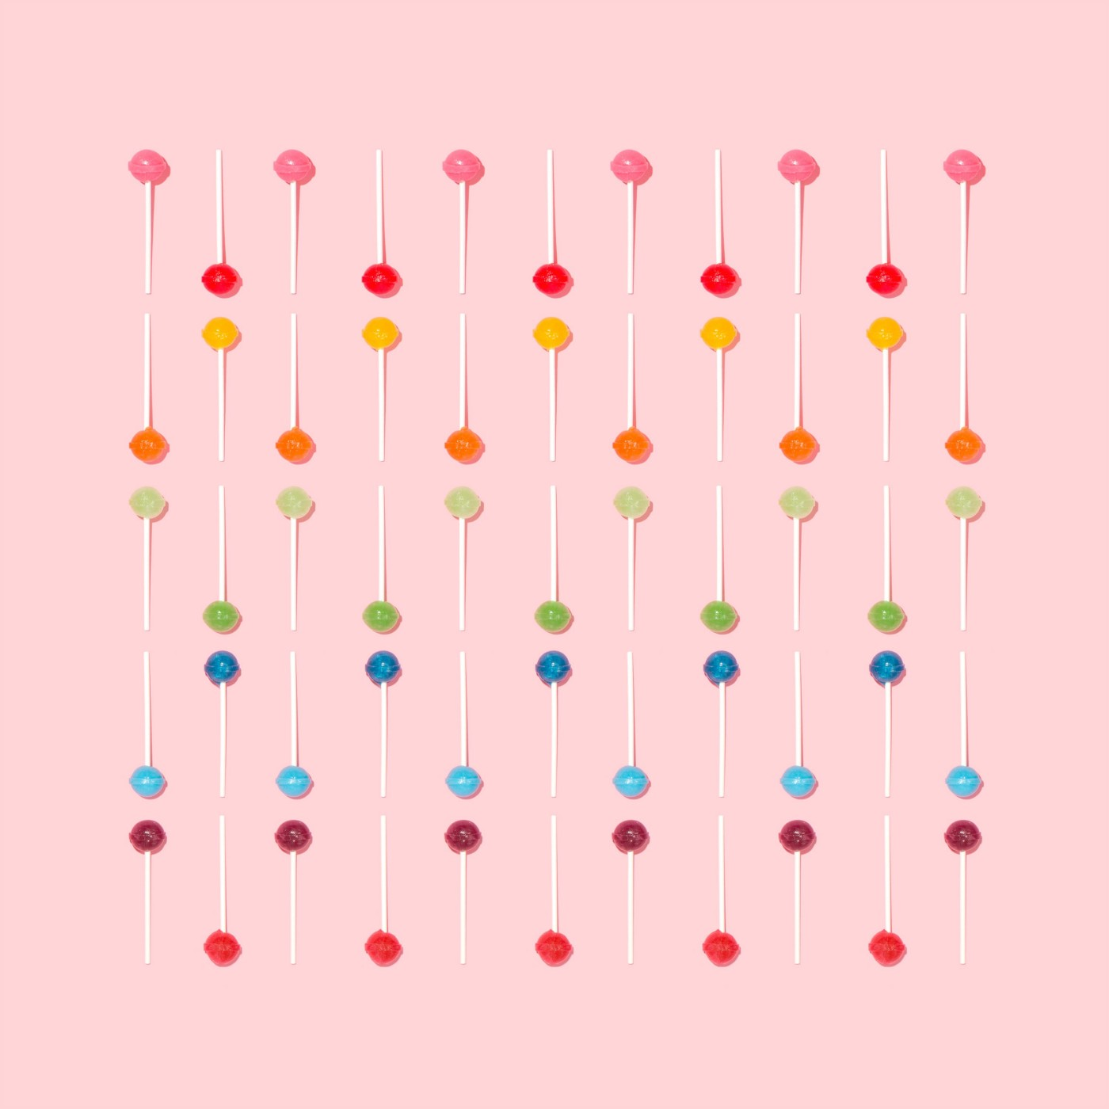

Slide 7
Lollipop Charts
AKA: lollipop plot
a lollipop chart (LC) is a handy variation of a bar chart where the bar is replaced with a line and a dot at the end.
Lollipop plots are used to make comparisons between different items or categories.
They are also used for ranking or for showing trends over time.
It can compare only one numerical variable per item or category.
They are not suitable for relationships, distribution, or composition analysis.

Slide 8
LCs are preferred to bar charts when you have to display a large number of similar high values.
In that case with a standard bar plot, it may get a cluttered chart and experience an optical effect called a Moiré pattern

Slide 9
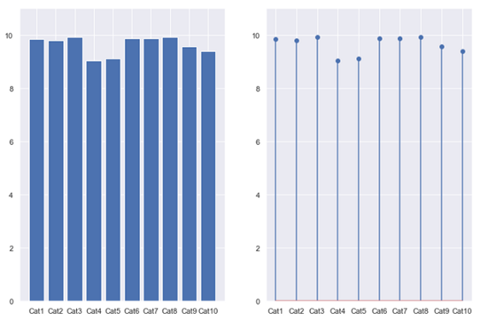
Fig. shows a bar chart on the left and a lollipop chart on the right side. Both are based on the same data but it is evident that the minimalist alternative of the lollipop results in a more attractive and clear visualization.

Slide 10
Read Yourself Slide
The Moiré effect is a visual perception that occurs when viewing a set of lines or bars that is superimposed on another set of lines or bars, where the sets differ in relative size, angle, or spacing.
Moiré patterns are those dark bands you see when looking through layered fences or when taking a picture of a TV or a computer screen.
Even though the Moiré effect can produce interesting and beautiful geometric patterns, they should be avoided in data visualization tasks so as not to confuse the audience.

Slide 11
lollipop charts are two-dimensional with two axes: one axis shows categories or a time series, the other axis shows numerical values.
Those numerical values are indicated by the position of the dot at the end of the line. A vertically oriented LC displays the categorical variable on the y-axis whilst a horizontally oriented LC displays it on the x-axis.

Slide 12
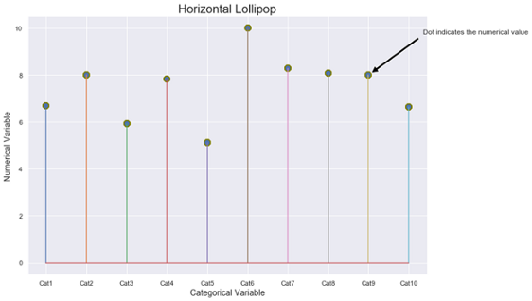
With Matplotlib, you must use the stem function to draw a horizontal lollipop. The stem function plots vertical lines from a baseline to the y-coordinate and places a marker at the top
Figure shows a schematic diagram of a horizontal LC where the dots at the end of the thin lines indicate the numerical value for each category.

Slide 13
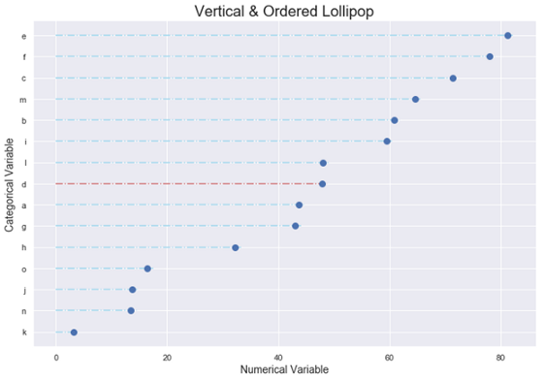
LCs are a nice alternative for rankings. The standard procedure is to arrange the categories in decreasing order and represent them vertically.
Notes:
With Matplotlib, you must use in combination the functions hlines and plot to draw a vertical lollipop. hlines draw horizontal lines at each y from the scalars xmin to xmax

Slide 14
Read Yourself Slide
Always start the numerical axis at 0: if the lines are truncated, the actual value is not properly reflected. Remember that our sight is very sensitive to differences in length when trying to compare data.
We inevitably distort the visual if we modify the baseline. If one of the variables is time (years, months, days, hours), always set it on the horizontal axis.
Time always runs from left to right and never from top to bottom.

Slide 15
Note
LCs are equivalent to bar charts, but this equivalence is only valid for standard bar charts; do not try to extend it to Stacked, Clustered, or Overlapping Bar Graphs

Slide 16
LCs were the subject of an interesting debate, both on a theoretical and conceptual level, between two data visualization heavyweights: Stephen Few and Albert Cairo (#6). Few through the sarcastic title “Lollipop Charts: “Who Loves You, Baby?” claimed that “LCs were inspired by the same thing that has inspired so many silly graphs: a desire for cuteness and novelty”. He added that the main problem with LCs was that: “The center of the circle at the end of the lollipop marks the value, but the location of the center is difficult to judge, making it imprecise compared to the straight edge of a bar, and half of the circle extends beyond the value that it represents, making it inaccurate”.

Slide 17
For his part, Cairo came out in defense of the charts indicating that: “I believe that lollipops have their uses. Bar graphs with more than, say, 8 or 9 bars, often look busy and clunky. Lollipop graphs may solve that problem by increasing the amount of white space in between bars significantly.” He proposed as a solution to reduce the size of the circles or even mark the numerical value with the upper point of the circle instead.

Slide 18
Eli Holder in a very interesting article published in Nightingale (#7) with the title: “Settling the Debate: Bars vs. Lollipops (vs. Dot Plots)” described an experiment to shed some light about: “How do lollipop charts affect readers’ comprehension? How much of our epistemic responsibility are we sacrificing for a playful aesthetic?” Finally, he concluded that the results of the experiments show no significant differences between Bar and Lollipop graphs and they led to roughly equal accuracy and equal response times. In the end, LCs provide a nice minimalistic visualization of the data and they should be used exactly in the same situation than a bar graph.

Slide 19
Storytelling with Lollipops
1.- Fuel Consumption with the mtcars dataset: Human activities have increased carbon dioxide emissions (CO2) and other greenhouse gases (GHC), driving up temperatures. Most man-made emissions of CO2 come from burning fossil fuels. GHG emissions from transportation account for about 28 percent of total U.S. greenhouse gas emissions, making it the largest contributor of the USA (#8). The United States Environmental Protection Agency had developed a national program for GHG and fuel economy standards for light-duty vehicles (passenger cars and trucks).

Slide 20
Previous studies on fuel consumption were based on Motor Trend Car Road Tests through the mtcars dataset. Data were extracted from the 1974 Motor Trend US magazine, and comprises fuel consumption and 10 aspects of automobile design and performance for 32 automobiles (1973–74 models). The following LC indicates miles traveled per gallon consumed for 32 car brands. Blue dash-dotted lines on the top correspond to those vehicles whose consumption was lower than the average (20.09 mpg) while the red dash-dotted lines correspond to those vehicles whose consumption was higher than the average. Clearly, a lollipop chart is better than a bar graph for comparing such a large number of different categories.

Slide 21
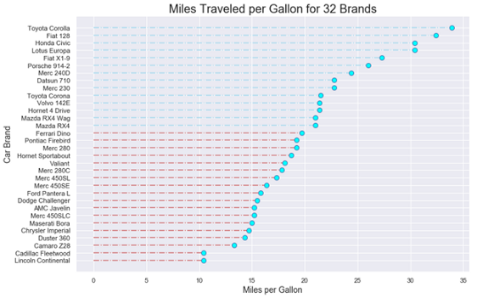

Slide 22
2.- Argentina´s Government Budget: A Government Budget is an itemized accounting of the payments received by government (taxes and other fees) and the payments made by government (purchases and transfer payments). A budget deficit occurs when a government spends more money than it takes in. The opposite of a budget deficit is a budget surplus.

Slide 23
Argentina grapples with one of the world’s highest inflation rates due to its recurrent government budget deficit. The next figure shows the country´s monthly budget deficit for the 2012–2018 period. Now, a lollipop chart allows us to follow the budget pattern over an extended period of time in an aesthetically pleasing way. As stated above, time runs from left to right on the horizontal axis.

Slide 24
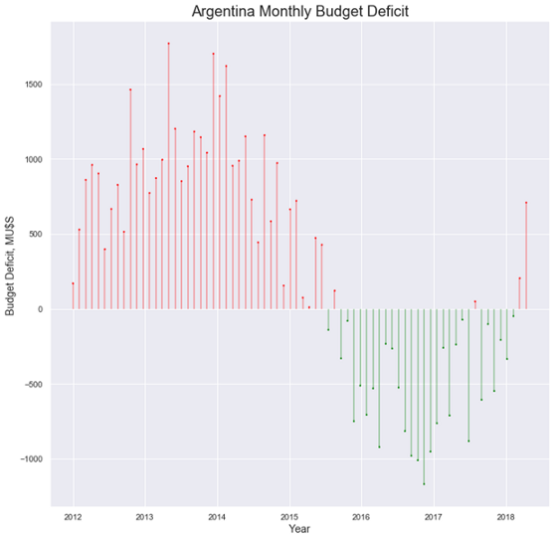

Slide 25
Variation

Slide 26
The Cleveland dotplot is a handy variation, allowing to compare the value of 2 numeric values for each group. This kind of data could also be visualized using a grouped or stack barplot. However, this representation is less cluttered and way easier to read. Use it if you have 2 subgroups per group.

Slide 27
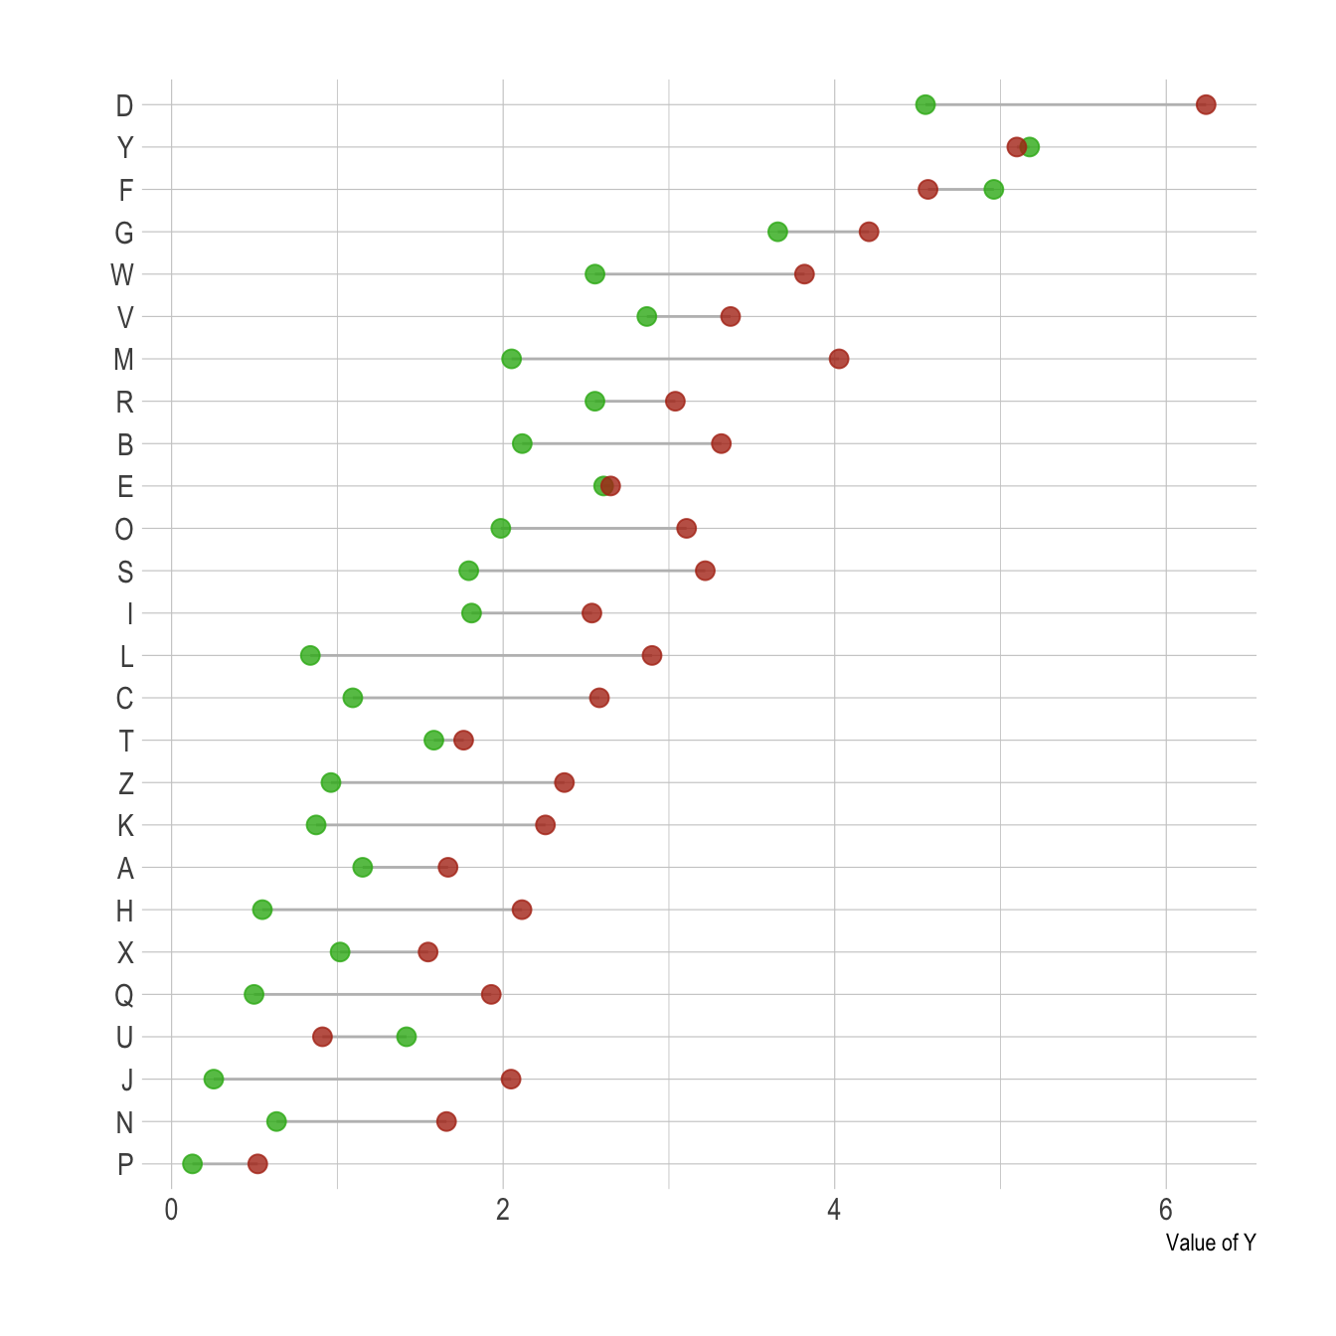

Slide 28
Python Script
# Create a dataframe
import pandas as pd
df = pd.DataFrame({'group':list(map(chr, range(65, 85))), 'values':np.random.uniform(size=20) })
# Reorder it following the values:
ordered_df = df.sort_values(by='values')
my_range=range(1,len(df.index)+1)
# Make the plot
plt.stem(ordered_df['values'])
plt.xticks( my_range, ordered_df['group'])
Notes:
https://www.python-graph-gallery.com/lollipop-plot/

Slide 29
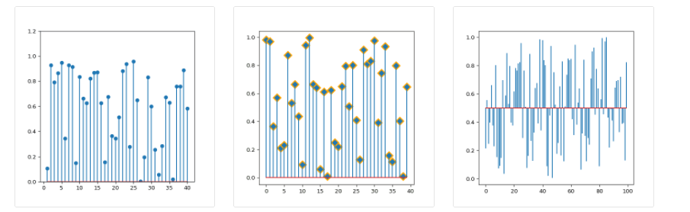
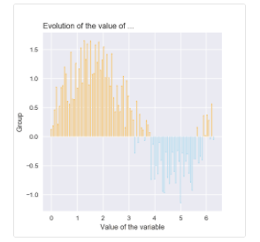

Slide 30
#1: https://en.wikipedia.org/wiki/Moir%C3%A9_pattern
#2: https://matplotlib.org/3.1.1/gallery/lines_bars_and_markers/stem_plot.html
#3: https://matplotlib.org/3.1.1/api/_as_gen/matplotlib.pyplot.hlines.html
#4: Darío Weitz, “Stacked Bar Graphs, Why & How, Storytelling & Warnings”
https://towardsdatascience.com/stacked-bar-graphs-why-how-f1b68a7454b7
#5: Darío Weitz, “Clustered & Overlapped Bar Charts, Why & How”
https://towardsdatascience.com/clustered-overlapped-bar-charts-94f1db93778e
#6: Stephen Few, “Lollipop Charts: “Who Loves You, Baby?
https://www.perceptualedge.com/blog/?p=2642
#7: Eli Holder, https://medium.com/nightingale/bar-graphs-vs-lollipop-charts-vs-dot-plots-experiment-ba0bd8aad5d6
#8: https://www.epa.gov/transportation-air-pollution-and-climate-change/carbon-pollution-transportation

Slide 31
LC with tableau
Step 1: Build a simple bar chart.
Drag dimension field ‘Sub-Category’ to the rows shelf.
Drag measure field ‘Sales’ to the columns shelf.
Select ‘Bar’ under the Marks card.
Notes:
https://www.rigordatasolutions.com/post/2018/09/08/tableau-charts-lollipop-chart

Slide 32
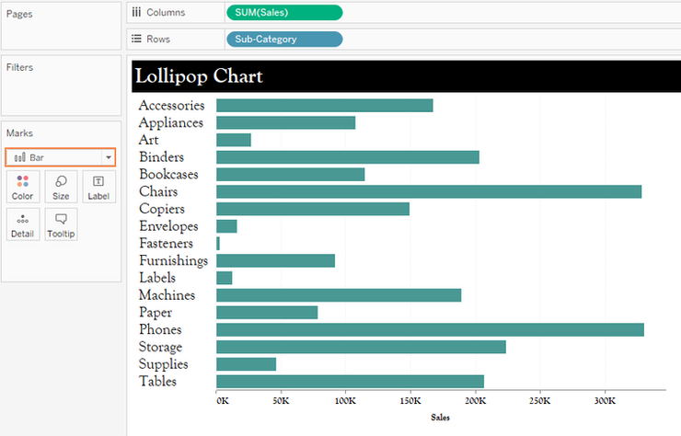

Slide 33
Step 2: Create a dual bar chart (duplicate the view).
Two ways to do this;
Hold down Ctrl key and drag the aggregate field SUM(Sales) in the columns shelf next to itself.
or
Drag the measure field ‘Sales’ to the columns shelf next to the aggregate field SUM(Sales).

Slide 34
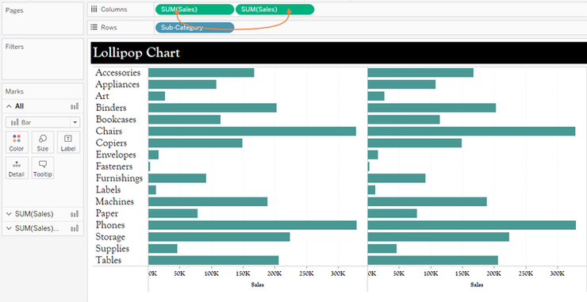

Slide 35
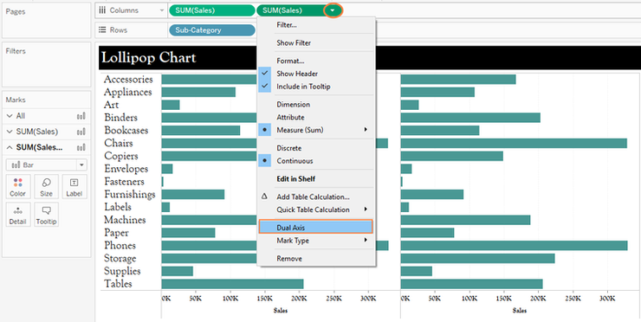
Make the charts dual.

Slide 36
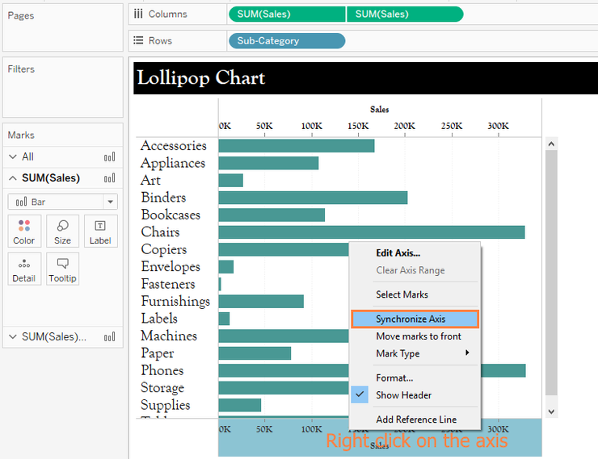
Synchronize the axis.

Slide 37
Step 3: Change the second bar chart to a circle.
This can be done as follows;
Select the second bar chart and change it to ‘Shape’ under marks card.
Choose circle on the ‘Shape’ tab.

Slide 38
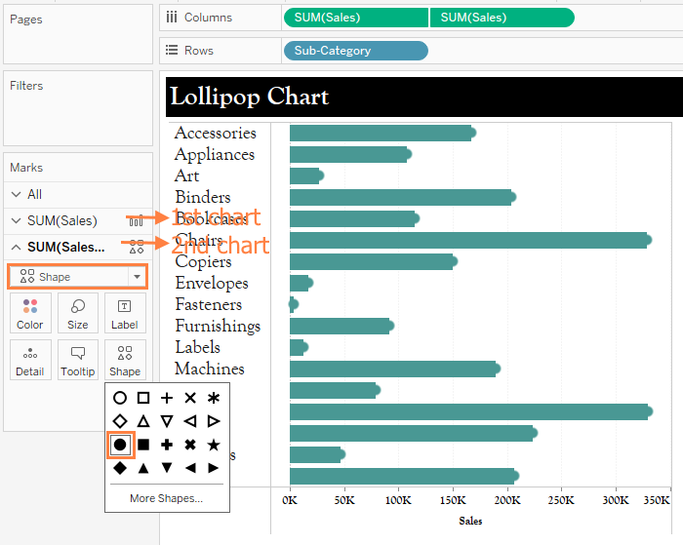

Slide 39
Adjust the two charts as follows;
Make the bar chart (1st chart) thinner and the circles (2nd chart) larger by adjusting their respective sizes under Size tab.

Slide 40
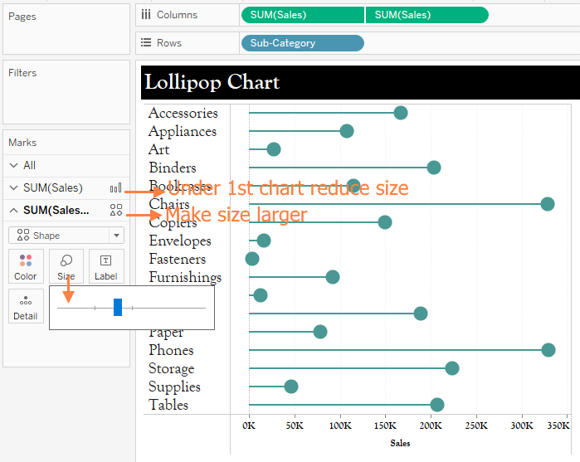

Slide 41
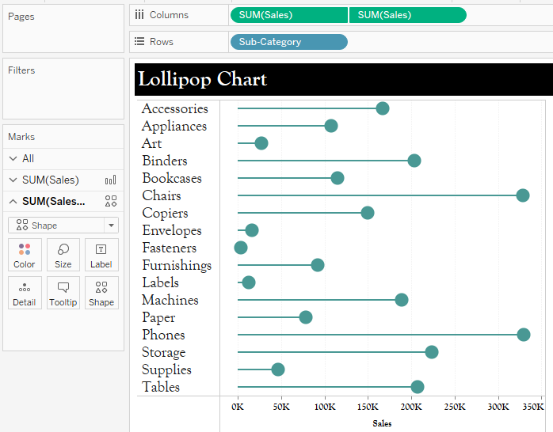
Executing this gives us the Lollipop chart below;

Slide 42
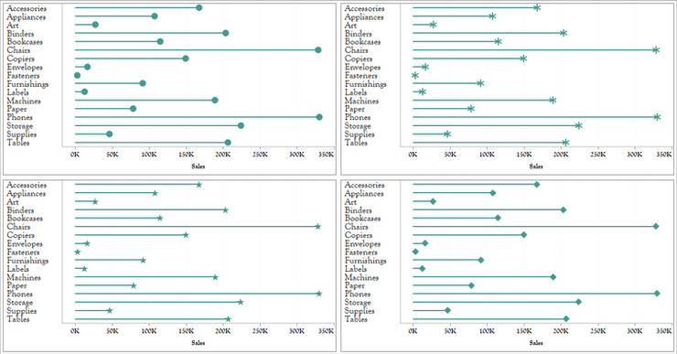
Note, the Shape tab of the second chart gives us a variety of icons we can use, giving us control of how we would like to present our data. See the few examples have compiled below.

Slide 43
Read Yourself Slide
A Lollipop chart doesn’t add any new insights if you were to compare it with a simple bar chart. But, it gives us a different way of presenting same insights, making users more interested in the viz, adding some fun and new perspective too.
Notes:
But this is not all we can do with the shapes in a Lollipop chart, we can add different icons other than the standard ones provided by Tableau, we can even add images which resonates with our data story to add some context.

Slide 44
LIKERT VISUALIZATIONS
Likert scales are the most widely used approach to scaling responses to gauge sentiment and tendencies, and are a staple of surveys and other types of data collection methodologies.
Several ways exist to ask Likert scale questions, as well as several ways to visualize their data.
This section provides a look at the two most common Likert scales and the best ways to visualize them: a 100% stacked bar chart and a divergent bar chart.

Slide 45
100% Stacked Bar Chart
A number of things need to be done to improve this basic 100% stacked bar chart to properly visualize the Likert data:
Color: The automatic color scheme in Tableau does little to help us see behaviors that are adjacent (for example, sometimes/often and just once/never). Using the Color Marks card, adjust these to a more suitable color palette.
Sort: Tendencies are sorted in alphabetical order rather than by how often they occur. Manually sort these to reflect the correct order.
Totals: A count of data is an okay option, but a better option (particularly in survey data) may be Percent of Total. Add in the correct table calculation to reflect this.
Curate: Remove unnecessary headers to clean up your canvas.

Slide 46
Divergent Stacked Bar Chart
Although the 100% stacked bar chart will work to represent Likert data, a better approach is a divergent bar chart, which is not actually a bar chart but a modified version of a Gantt chart.
Rather than stacking tendencies or sentiment ratings on a scale of 0 to 100, this approach shows the spread of negative and positive sentiment values (such as Strongly Disagree to Strongly Agree) aligned to each other around
the neutral midpoint (see Figure 9.20).

Slide 47
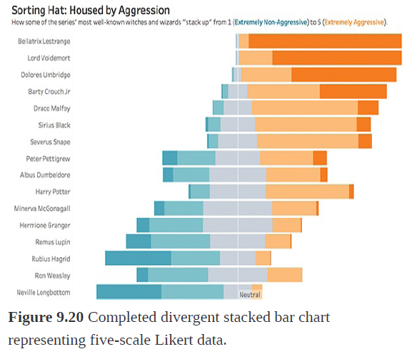
Divergent Stacked Bar Chart

